Slide 1
CS3244 Team 43
Ng Hui Wen
Nicholas Loo Wei-Hao
Low Kaiwei
Yap Teng Chiong
Zhang Aijia

Slide 2

Introduction
Predicting Stock Prices
To predict the stock market correctly is a difficult task. The stock market is volatile and the value of a stock is affected by many factors such as news announcements, supply and demand, interest rates, inflation, natural calamities.
As such, our team aims to find out if using machine learning is able to crack this difficult task by using various several financial analysis techniques and supervised learning models.

Slide 3
Tasks
01
02
Predicting next day Close Price
Predicting change in stock price
We aim to build a general price predicting model, that can predict stock prices for companies in the technology sector.
Classification:
If stock price will go up or down next day
Help traders decide whether to buy or sell a stock
Regression:
Predict how much a stock’s price will increase or decrease
Help traders decide which stock is more worthy to buy

Slide 4


Challenges
Random walk hypothesis: Changes in stock price have the same distribution and are independent of each other
For regression, can we outperform the Martingale series ?
For classification, can we do better than tossing a coin?
Notes:
Random walk hypothesis: Changes in stock price have the same distribution and are independent of each other. It follows that the stock price is a martingale series where probability of price going up tomorrow is the same as the probability of it going down, and the best prediction for next day price is the price today

Slide 5
Literature review
Time Series Prediction: Predicting Stock Price. By: Aaron Elliot and Cheng Hua Hsu
A linear model never beats the martingale, and performance gets worse when more lags are included
LSTM-RNN either learns the martingale series, or performs worse

Slide 6
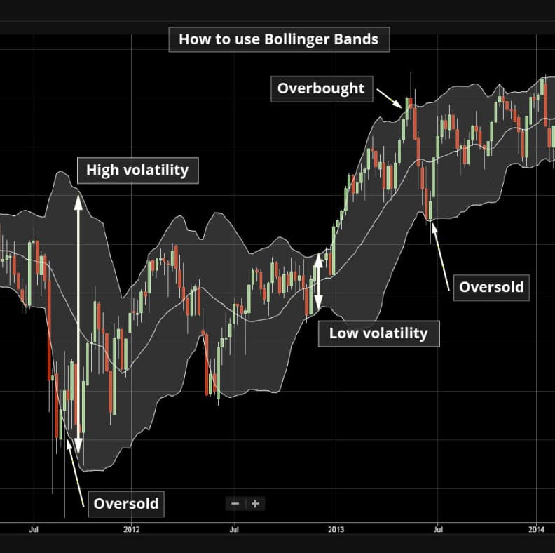

Domain Knowledge
Bollinger bands
Developed by John Bollinger
Bands = 20 days SMA ± 2*20 days moving stdv
Signals:
Close to upper band: Overbought
Close to lower band: Underbought
Tight margin: Increase in volatility in the future
Mean reversion theory
Financial theory which states that the price of an asset will eventually revert to its long run mean
Hypothesis: The larger the difference of the current price from the long run mean, the more likely it will change its direction to move towards to long run mean
Exponential averages
In the .ewm() function from the pandas package, smoothing factor, alpha is calculated as follows:
EMA vs SMA:
Put higher weight on more recent prices
10 days EMA is often used for short term analysis
50 -200s EMA is often used for long term price analysis
Quoting financial experts, if stock price crosses its 200 days EMA, it is a signal that reversal has occurred.
Notes:
Image credit: City index

Slide 7
Data preprocessing
Scape Environmental Social Governance score from sustainalytics.com. ESG score might have an effect on stock.
We used stock data from Kaggle and focus on 35 tech companies.
Calculate the moving average, bollinger band, remove features with high correlations (open, high, low)
Add two targets columns:
Next day closing price
Change of price

Slide 8
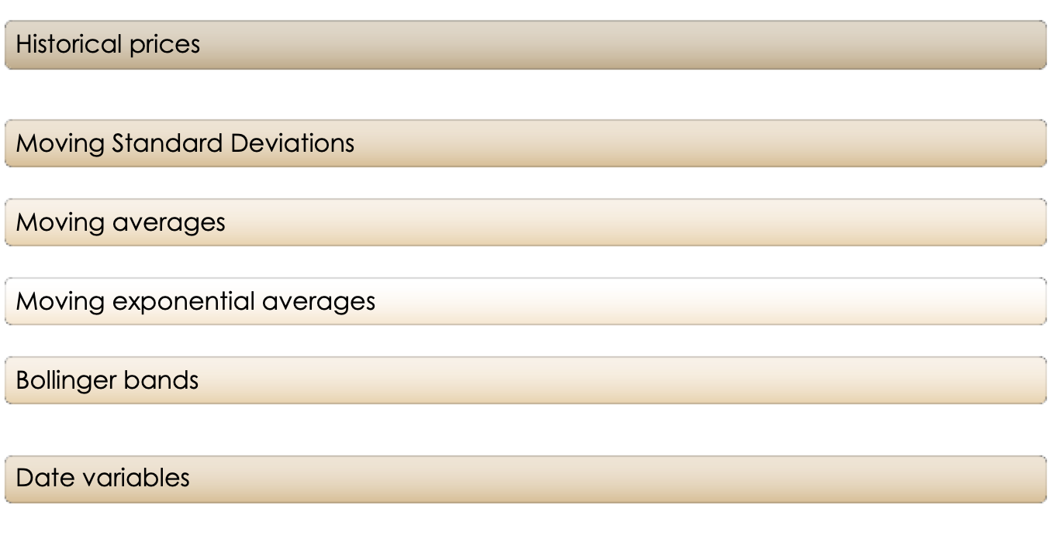
Feature engineering

Slide 9
Proposed Models for two targets
Tasks
Next day stock price
Next day change in price
Regression
Classification
Regression
Regression Approach: Linear Regression
Ensemble Approach: Boosting (XGBoost, LightGBM)
Deep Learning Approach: LSTM
Decision Tree Approach: Decision Tree
Ensemble Approach: Boosting (XGBoost, LightGBM)
Deep Learning Approach: RNN
Deep Learning Approach: LSTM

Slide 10
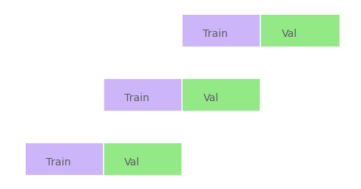
Validation and Evaluation Metric
Rolling time series train test split for cross validation:

Slide 11
Evaluation Metrics
Regression: Root Mean Squared Error (RMSE)
Minimize RMSE ⇔ Minimize MSE
Minimize MSE ⇒ Wants prediction to be close to actual, and want to penalize large errors
Large errors may lead to great loss for investors
To be avoided, as people are risk averse
Classification: Accuracy
Maximise accuracy
Help traders make accurate decision base on forecast
If price to drop, sell the stock
If price to increase, hold the stock

Slide 12
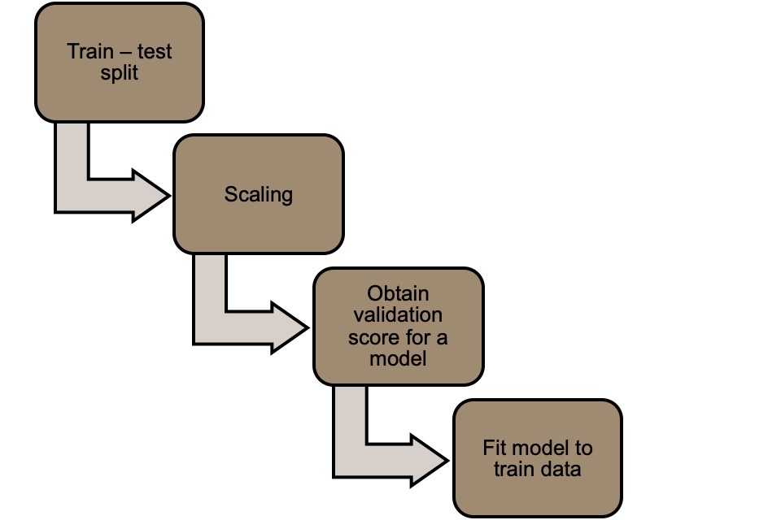
Pipeline

Slide 13
Linear Regression

Slide 14

Linear Regression
Why:
Easy model to implement and interpret
Has extrapolating ability to a certain extent
Under assumption that future trend is similar to historical trend
Cons:
Prone to overfitting
Mitigate with Ridge, RFE

Slide 15
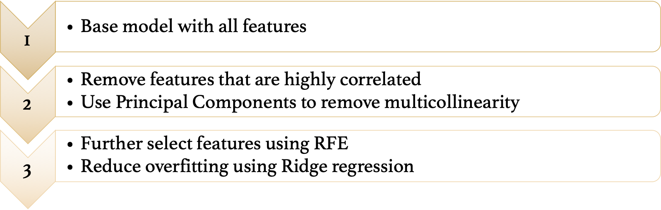
Model selection process

Slide 16
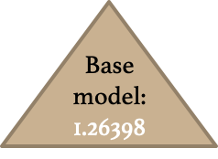
Converted EGS score, Month and Day features to dummy variables
Trained with all 86 features
Cross validation score: 1.26398
Training score: 1.05999

Slide 17
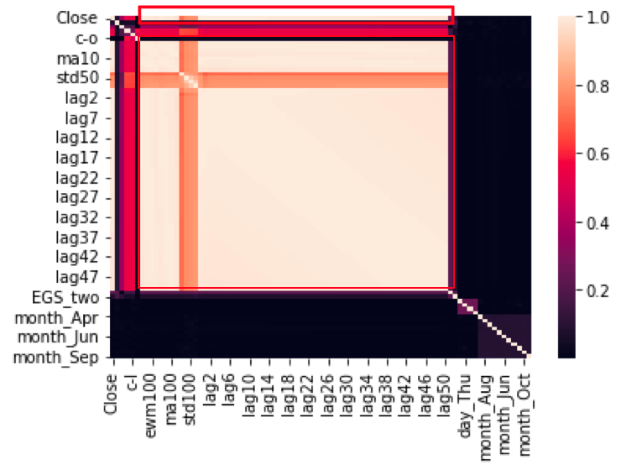
A lot of features can be removed as they are highly correlated with each other

Slide 18
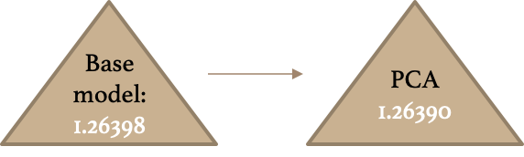
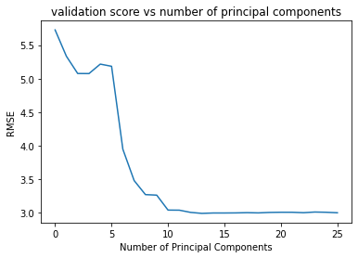
Used PCA to create feature column that are orthogonal to each other
However, still needed to select all the columns in order to have a low validation score
Not effective in helping to reduce features
Notes:
After using RFE on the set of principal components, the algorithm selected all 86 columns
Not able to reduce number of features this way
Components with high variation not necessarily good for predicting the target variable.

Slide 19
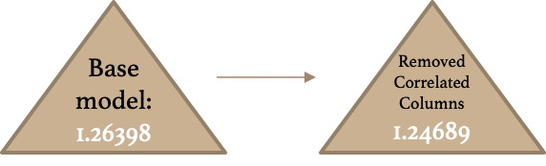
86 features
27 features
Reduced dimension from 86 to 27
Validation score improved
Train score: 1.06964
Overfitting has been mitigated

Slide 20
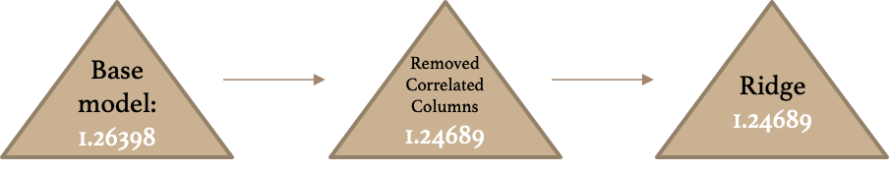
Used L2 regularization
Result of GridSearchCV for the best parameter alpha: alpha = 0.1
Validation score decreased by a very small amount (0.000001)
Train score: 1.06964
We reduced overfitting by a little bit more

Slide 21
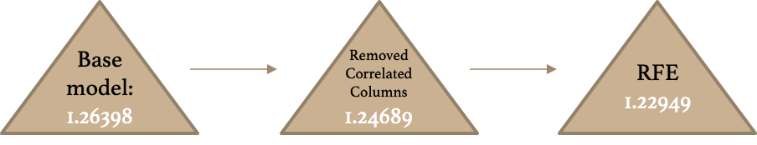
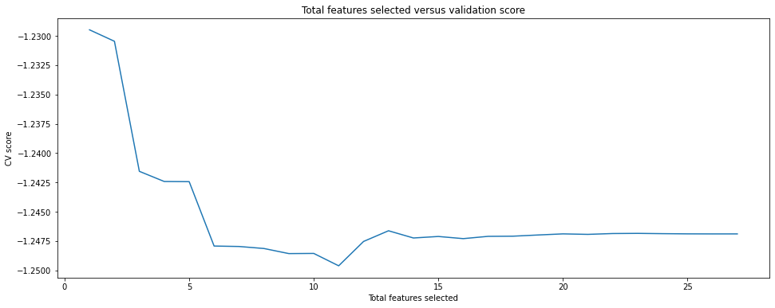
RFE selected only one feature – Closed price today
Validation score decreased when more features were added
With only 1 feature, validation score improved to 1.22949
Train score: 1.07175
Overfitting reduced even more

Slide 22
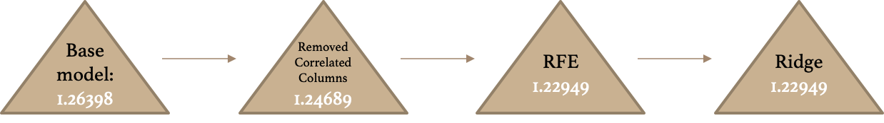
To further reduce overfitting, we used ridge regression on the rfe selected model
GridSearchCV results: Best alpha = 0.1
Slight improvement in validation score: -0.000001
Based on the validation scores for the models so far, this model should be selected as the best model
Train score 1.07175

Slide 23
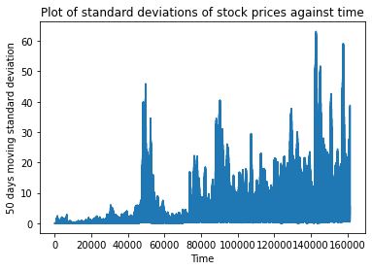
Testing the models
 | Base model | PCA | Correlated columns removed | Ridge | RFE | RFE + Ridge
Test Score | 2.73058 | 2.73142 | 2.71638 | 2.71638 | 2.72083 | 2.72083
Validation Score | 1.26398 | 1.26390 | 1.24689 | 1.24689 | 1.22949 | 1.22949
Here, we see that the model we chose based on the best validation score did not perform the best on the test data set .
The validation errors are in general lower than the test errors
May be due to the increase in volatility of stock prices across time.
Notes:
Surprisingly, it seems like our linear regression model has beat the Martingale series!
However, this result may not be consistent
Choosing model from validation score – model that best predicts stock price in the range we already know.
However, future prices are generally outside this range, and there is no guarantee that future price trends follows historical trends.
May be due to the increase in volatility of stock prices across time, which results in increase of stochastic noise and thus less accurate predictions.

Slide 24
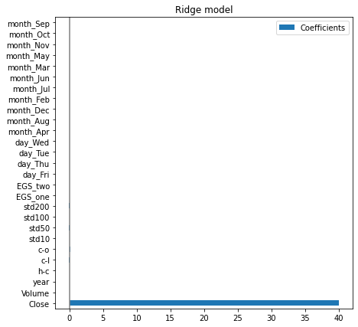
Model Selected
Coefficient for the Ridge model with 27 features:
Features other than “Close” have coefficient of almost 0
Select the RFE Ridge model with only the “Close” feature instead
Better average score on the validation sets

Slide 25
Comparing with Martingale Series
Martingale hypothesis test score : 2.72439
Regression equation using Martingale hypothesis:
Regression equation using RFE Ridge model:
Given that there is a general upwards trend in stock prices, it makes sense that E(Y) > Price today

Slide 26
Decision Tree Regressors

Slide 27
Decision tree regressor
Low train error: 3.62419e-17
Very high test error: 44.99473
Range of predictions on X test dataset is within the range of predictions on X train dataset
Tree model cannot extrapolate
 | Min | Max
Prediction on X train | 0.103790 | 610.080000
Prediction on X test | 1.543300 | 609.800000
Notes:
Tree model cannot extrapolate – Cannot predict values beyond the range of target which it has seen
For stock prices, general upwards trend – Data to predict generally have greater values compared to train data, thus the bad performance of decision tree.

Slide 28
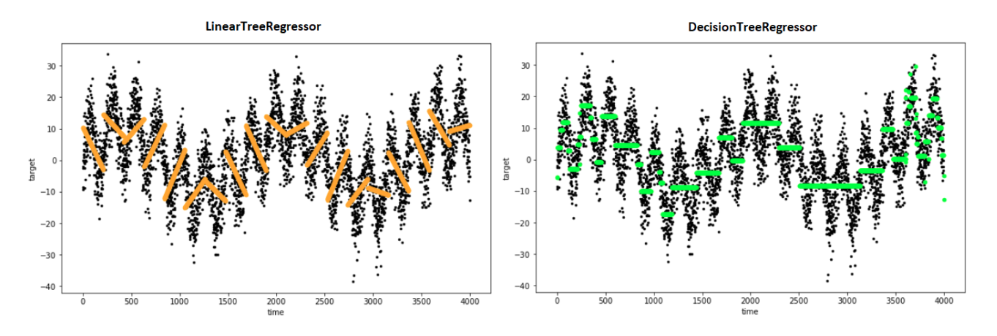
Decision tree regressor vs Linear Tree Models
Leaf nodes are linear regression models vs leaf nodes being constants for the usual decision tree
Thus harness the ability of linear models to extrapolate beyond seen target values

Slide 29
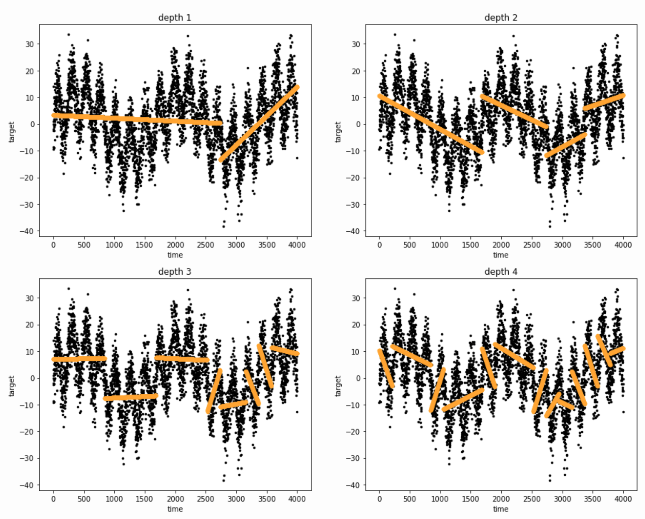
Decision tree with linear models
Pros:
As depth increases, trend becomes more “segmented” – More flexible piecewise linear models
Cons:
More leaves – Less data at each leaf to train each linear model
More prone to overfitting
Source credit: https://pypi.org/project/linear-tree/

Slide 30
Experimenting with linear trees
A linear tree model performed much better than a classical decision tree regressor.
However:
Both validation and test scores are higher than Linear Regression models
Decreasing the depth seems to improve the validation score, but did not help to improve the test score.
 | Tree 1 | Tree 2
Depth | 5 | 3
Validation score | 1.42924 | 1.42147
Train | 1.06915 | 1.06915
Test | 2.75008 | 2.75008
We tried to proceed with more powerful tree models – Gradient Boosting Trees

Slide 31
Boosting (LightGBM, XGboost)

Slide 32
Boosting (LightGBM, XGboost)
What is Gradient Boosting?
Boosting is a method of converting weak learners into strong learners. It is a sequential technique which works on the principle of an ensemble. It combines a set of weak learners and delivers improved prediction accuracy. At any instant t, the model outcomes are weighed based on the outcomes of previous instant t-1. The outcomes predicted correctly are given a lower weight and the ones mis-classified are weighted higher.

Slide 33
Boosting (LightGBM, XGboost)
Pros:
Generally more accurate compared to other models
Trains fast on large datasets
Has extrapolating capabilities
Cons:
Prone to overfitting, though this can be rectified by applying L1/L2 regularisation
Hard to interpret final models

Slide 34
Pipeline
Remains the same as the General Pipeline
After feature scaling, tune hyperparameters using GridSearchCV

Slide 35
Base Model - Regression
RMSE | LightGBM Boosting
Train score | 0.77
Validation score | 16.0
Test score | 16.0

Slide 36
Hyperparameter Tuning
“reg_alpha” - provides l1 regularization to the weight, higher values result in more conservative models
“reg_lambda” - provides l2 regularization to the weight, higher values result in more conservative models
“learning_rate” - applies a weighting factor for the corrections by new trees
“max_depth” - how big tree should be
“linear_tree”, set to True - linear trees extrapolate as linear functions whereas usual trees stagnate
XGBoost: gbtree vs gblinear - ensemble of trees. For the linear booster, it will be a weighted sum of linear functions

Slide 37
Hyperparameter Tuning
Recursive Feature Elimination?
“feature_fraction” enables us to restrict the number of features before training.
Combined with GridSearchCV, we can determine the optimal “feature_fraction” to use.

Slide 38
Hyperparameter Tuning - Regression
LightGBM Boosting:
feature_fraction = 0.5, learning_rate = 0.05, linear_tree = True, max_depth = 3, metric = 'root_mean_squared_error', num_leaves = 18, objective = 'regression', random_state = 0, reg_alpha = 0.5, reg_lambda = 0
XGBoost:
learning_rate = 0.2, n_estimators = 500, booster = ‘gblinear’, eval_metric = ‘rsme’

Slide 39

Boosting Comparison - Regression
Trained with all features on tomorrow close price
RMSE | LightGBM Boosting | XG Boosting (gblinear) | Default Linear Tree model | Default Linear Regression | RFE + Ridge Linear Regression
Train score | 1.15 | 1.33 | 1.07 | 1.06 | 1.07
Validation score | 2.47 | 1.68 | 1.43 | 1.26 | 1.23
Test score | 3.05 | 3.51 | 2.75 | 2.73 | 2.72
Gradient Boosting Trees: < 5 sec
Simple Linear Tree Model: < 45 ~ 50 sec

Slide 40
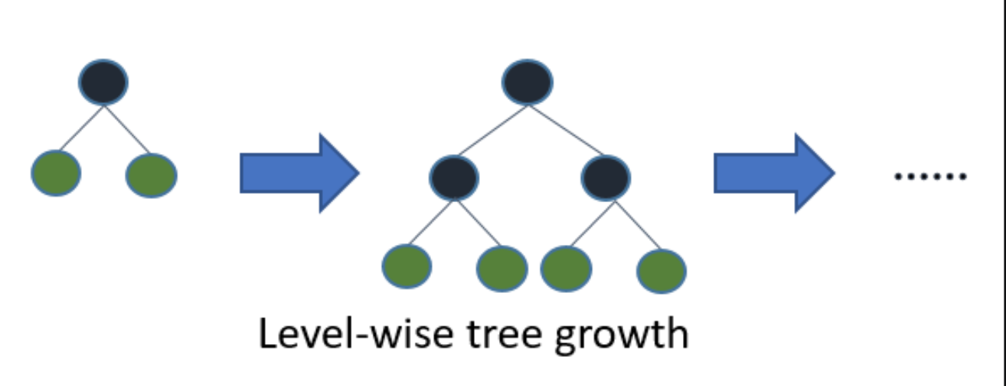
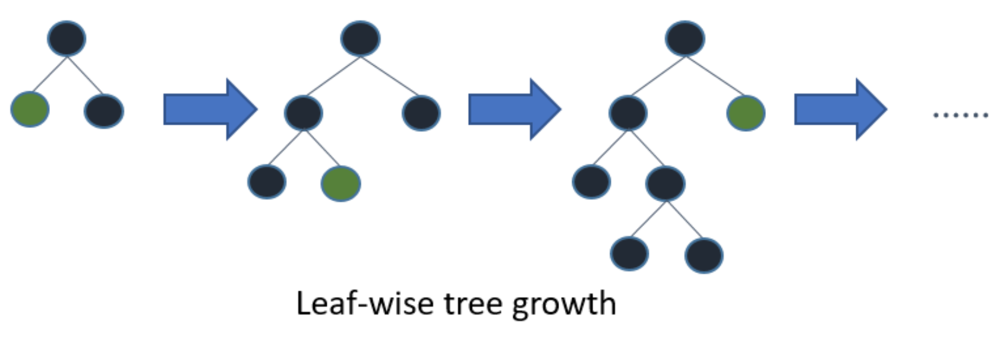
Boosting Analysis
LightGBM performs better than XGBoost
XGBoost
LightGBM

Slide 41
Boosting Analysis
LightGBM performs slightly worse compared to default Linear Tree
Trees in LightGBM grow vertically, so LightGBM is prone to overfitting

Slide 42
Boosting Comparison - Classification
Trained with all features on change in price
Accuracy | LightGBM Boosting | XG Boosting (gbtree) | Default Decision Tree
Train score | 0.57 | 0.59 | 1
Validation score | 0.51 | 0.51 | 0.50
Test score | 0.52 | 0.52 | 0.50

Slide 43
Confusion Matrix
LightGBM Boost |  | Predicted
 |  | + | -
Actual | + | 3599 | 10366
 | - | 3982 | 12053
XgBoost |  | Predicted
 |  | + | -
Actual | + | 3771 | 10194
 | - | 4083 | 11952
DT |  | Predicted
 |  | + | -
Actual | + | 5968 | 7997
 | - | 6965 | 9070
Precision: (+) 0.47 , (-) 0.54
Recall: (+) 0.25, (-) 0.75
F1: (+) 0.35, (-) 0.63
Precision: (+) 0.48, (-) 0.54
Recall: (+) 0.27, (-) 0.75
F1: (+) 0.35, (-) 0.63
Precision: (+) 0.46, (-) 0.53
Recall: (+) 0.43, (-) 0.57
F1: (+) 0.44, (-) 0.55
Notes:
Actual positives: 13965 (0.4655)
Actual negatives: 16035 (0.5345)

Slide 44
Boosting Results
Actual positives: 13965 (46.55%) ~ Precision for positives for a random model
Actual negatives: 16035 (53.45%) ~ Precision for negatives for a random model
 | Precision |  | Recall |  | F1
 | + | - | + | - | + | -
LightGBM | 0.47 | 0.54 | 0.25 | 0.75 | 0.35 | 0.63
XGBoost | 0.48 | 0.54 | 0.27 | 0.75 | 0.35 | 0.63
Decision Tree | 0.46 | 0.53 | 0.43 | 0.57 | 0.44 | 0.55
The precision of all 3 models are no better than a random model, but XGBoost and LightGBM shows improvement in recall for negatives.
Notes:
Recall = P(price goes down|predicted it will go down) => high recall might be helpful in warning against fall in stock prices

Slide 45
Boosting Analysis
Recall = P(price goes down | predicted to go down)
Negative recall is useful as we are more concerned with when prices will trend downwards.
A high negative recall is helpful in alerting us in the fall of stock prices.
Both boosting models provide higher recall for negatives.

Slide 46
Boosting Analysis
Our result is not much better than flipping a coin: stock price might be too volatile and fluctuate frequently to predict correctly
Our boosting models only did slightly better than default models.
Maybe Neural Network models perform better… let’s find out!

Slide 47
RNN & LSTM

Slide 48
RNN & LSTM - Motivation
Key reasons:
Time series data
Model can use long term information to determine trends
Trends may be useful in determining how the price will change
For example, upward trend may mean a higher probability that the price will go up

Slide 49
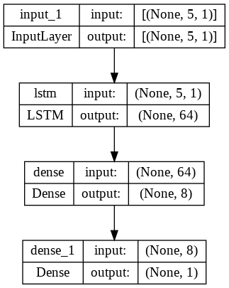
RNN & LSTM
Base Model:
One LSTM layer and 2 dense layers
Variables that we explored:
Learning Rate
Epochs
Dropout
Activation Function
Recency of Data
Predicting Target using past 5 days
Used Apple stock data from 1984 till 2017
Used a 0.875, 0.05, 0.075 split for training, validation and test

Slide 50
LSTM - Positive or Negative Change (Classification)
Predicting if change is positive or negative:
Best performing model
Modelled on data from 2010 onwards
300 Epochs, learning rate of 0.0001
Using ReLU on the first dense layer and linear activation on the second
Validation Accuracy | 0.525
Testing Accuracy | 0.548

Slide 51
LSTM - Positive or Negative Change Analysis
Results are very close to random chance of 0.5
Not very meaningful model
Validation Accuracy | 0.525
Testing Accuracy | 0.548

Slide 52
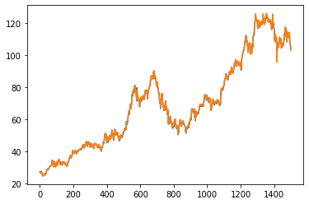
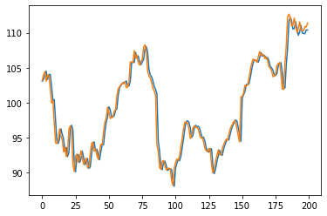
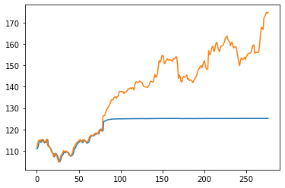
LSTM - Daily Average (Regression)
Predicting Daily Average:
Best performing model
Modelled on data from 2010 onwards
100 Epochs, learning rate of 0.0005
Using ReLU on the first dense layer and linear activation on the second
Train Prediction vs Actual
Validation Prediction vs Actual
Test Prediction vs Actual
Notes:
10% Dropout, 30% Dropout
500 Epochs, 100 Epochs

Slide 53
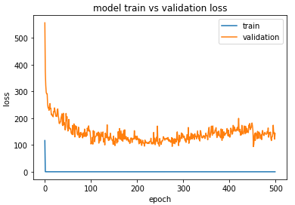
LSTM - Daily Average Analysis
Test Prediction vs Actual
Plateau observe on test predictions
Happens after certain threshold
Threshold > highest price seen in training and validation
Observed that validation loss higher than training loss
Validation loss also increasing -> Overtraining
Tried reducing epochs and introduce dropouts
Tried using more recent data
Best efforts still result in plateau
Neural Networks have difficulty in extrapolation
Notes:
10% Dropout, 30% Dropout
500 Epochs, 100 Epochs

Slide 54
LSTM - Next Steps (Regression)
Key Ideas:
Get rid of the need to extrapolate
Use first-difference (change in price the next day)
Use recent data
Observed that accuracy increased when we used 2010-onward data
Notes:
10% Dropout, 30% Dropout
500 Epochs, 100 Epochs

Slide 55
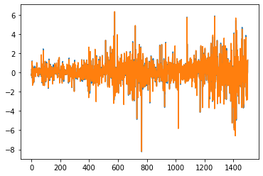
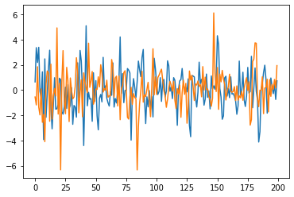
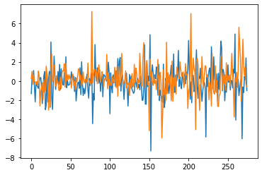
LSTM - First Difference (Regression)
Predicting First Difference (Change in price next day):
Best performing model:
Modelled on data from 2010 onwards
500 Epochs, learning rate of 0.0001, batch size 32
2 Linear dense layers
Train Prediction vs Actual
Validation Prediction vs Actual
Test Prediction vs Actual
Notes:
Base Model of 1 LSTM layers with 2 Dense layers
Varying Learning Rate: Learning rate of 0.001, 0.0005, 0.0001
Varying Epochs: Epochs of 30, 100, 300, 500, 700, 1000
Varying Model: With 2 dense layers, Without the dense layers
Varying Dropout: Dropout of 0.1, 0.3
Varying Inputs in LSTM layer: From 5 to 3 days window, Experimented with 7-diff

Slide 56
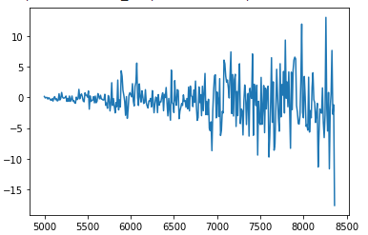
LSTM - First Difference Analysis
Train Prediction vs Actual
Data points are too noisy:
Many sharp rise and falls in gradients
Too complex to model
Improvements attempted:
Predict 10-day difference (change in price after 10 days)
Less complex
Issues:
10-day difference still complex to model
Not enough data points to model
10-Day Difference
Notes:
Base Model of 1 LSTM layers with 2 Dense layers
Varying Learning Rate: Learning rate of 0.001, 0.0005, 0.0001
Varying Epochs: Epochs of 30, 100, 300, 500, 700, 1000
Varying Model: With 2 dense layers, Without the dense layers
Varying Dropout: Dropout of 0.1, 0.3
Varying Inputs in LSTM layer: From 5 to 3 days window, Experimented with 7-diff

Slide 57
LSTM - Next steps
Read papers/articles on LSTM for stock price prediction
Most predict close price
Used Normalization
Gets past the extrapolation problem
Normalize training data
Use parameters for training data to normalize testing data
Notes:
Base Model of 1 LSTM layers with 2 Dense layers
Varying Learning Rate: Learning rate of 0.001, 0.0005, 0.0001
Varying Epochs: Epochs of 30, 100, 300, 500, 700, 1000
Varying Model: With 2 dense layers, Without the dense layers
Varying Dropout: Dropout of 0.1, 0.3
Varying Inputs in LSTM layer: From 5 to 3 days window, Experimented with 7-diff

Slide 58
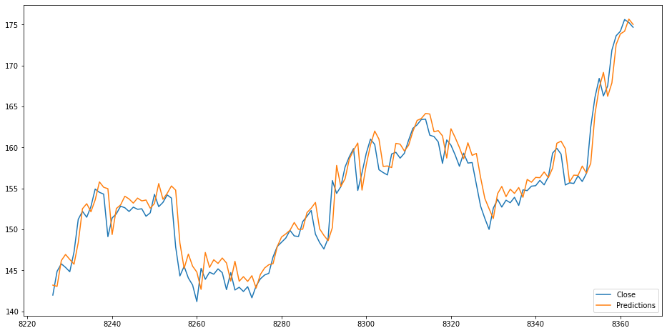
LSTM - Close Price
Predicting Close Price:
Best performing model:
Modelled on data from 2010 onwards, but with 60 days of previous close prices
1 lstm layer, 1 extra lstm layer and 2 Linear dense layers
3 Epochs, learning rate of 0.001, batch size of 1, normalization before splitting
Test Prediction vs Actual
Train RMSE | 0.040000
Validation RMSE | 0.008310
Test RMSE | 0.762422
Martingale RMSE | 0.235797
Notes:
Looks like its offset by a day or two
Referenced https://medium.com/the-handbook-of-coding-in-finance/stock-prices-prediction-using-long-short-term-memory-lstm-model-in-python-734dd1ed6827

Slide 59
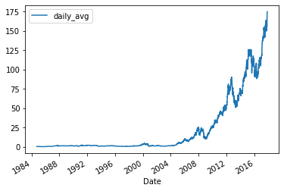
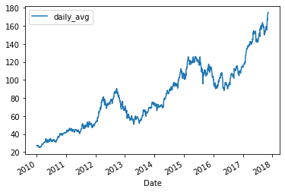
LSTM - Review
Old prices did not grow as rapidly
Newer data created more accurate models
At the cost of less data points
First Difference is hard to model
Many Fluctuations
Higher complexity causes overfitting
Notes:
https://www.sciencedirect.com/science/article/pii/S1877050920304865
Faced similar issues when using less training data with an epoch of 25, but they mitigated this by increasing the epochs to 100 and reducing the amount of training data

Slide 60
LSTM - Review
LSTM does not extrapolate data very well, ends up predicting the max value
Was mitigated when we used less training data.
Other researchers have similar issues with extrapolation, where their model is unable to follow the increase
Notes:
https://www.sciencedirect.com/science/article/pii/S1877050920304865
They were able to mitigate, and so were we
Faced similar issues when using less training data with an epoch of 25, but they mitigated this by increasing the epochs to 100 and reducing the amount of training data

Slide 61
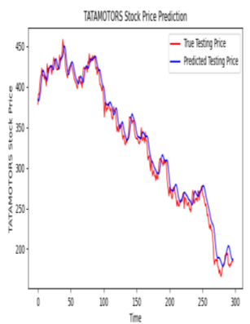
LSTM - Review
Predictions could be more reliable if there was an increased number of layers
More complex model to fit more complex problem
Was done by other researchers predicting for TATAMOTORS stocks
Image taken from research paper
Notes:
https://www.researchgate.net/profile/Mallikarjuna-Pm/publication/348390803_Stock_Price_Prediction_Using_LSTM/links/5ffc6a23a6fdccdcb84a20f8/Stock-Price-Prediction-Using-LSTM.pdf
Prediction could be more reliable if the model trains a greater number of data sets using higher computing capacities, an increased number of layers, and LSTM modules.

Slide 62
LSTM - Comparisons
Predicting Stock Prices using LSTM
Some researchers used additional features to help train their model
Tested using high, low, close, at one go to predict stock prices
Stock Price Prediction Using LSTM
Similar extrapolation problem that we encountered
Stock Prices Prediction Using Long Short-Term Memory (LSTM) Model in Python
Inspired us to use normalization, took reference from this article
Gave us similar result, but normalized test values might not always be good

Slide 63
Further improvements for the future
More features selection and engineering (To find features that might influence the market like news headline)
Increase instances
Expand to include more companies

Slide 64
Conclusion
Did we accomplish our goal?
Predicting next day stock price
With Regression
Came very close with predicting close for 1 company with LSTM, however, it is still worse than the martingale series
Linear regression managed to outperform the martingale series by training with data from 35 companies
Predicting change in stock price
With Classification
Unfortunately accuracy was all close to 0.5
With Regression
Test scores were around 2.7 using RMSE

